Slide 1
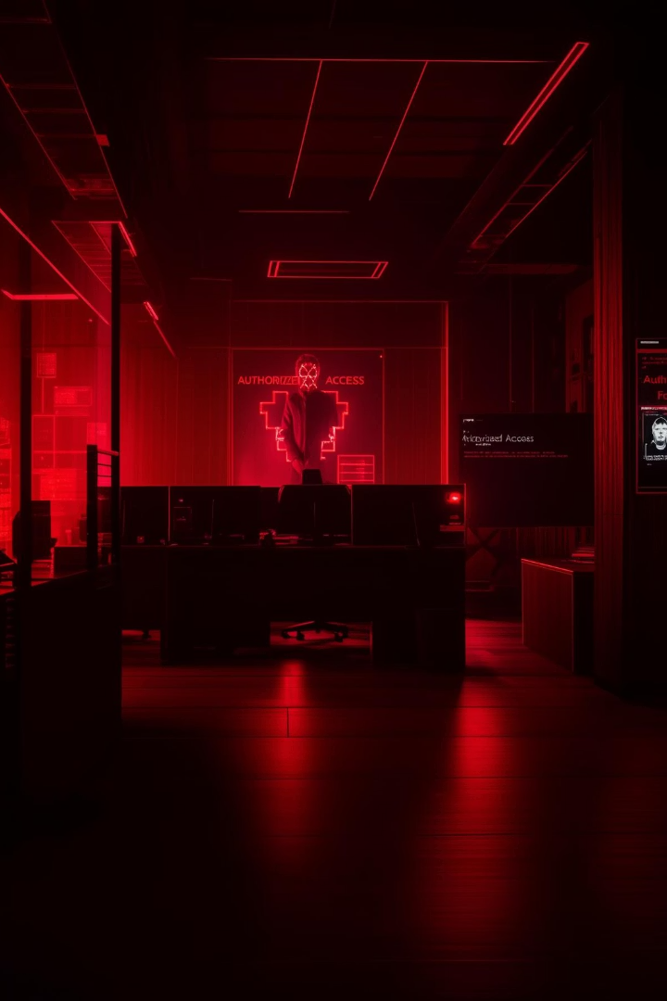
Face Recognition Attendance System (FRAS)
Welcome to my presentation on Face Recognition Attendance System (FRAS), a cutting-edge technology revolutionizing how organizations track attendance. This advanced system uses facial recognition to automate and enhance traditional attendance tracking methods.
While traditional methods rely on manual sign-ins, paper logs, or magnetic cards, FRAS offers a contactless, efficient alternative that has evolved significantly since early facial recognition technology emerged in the 1960s. Today's systems leverage sophisticated artificial intelligence and machine learning algorithms for remarkable accuracy.
The FRAS market is experiencing explosive growth, with projections indicating it will reach $8.5 billion by 2028 as more organizations recognize its transformative potential.
by Priyansh Verma

Slide 2





How FRAS Works: Core Components
Cameras
High-resolution webcam strategically positioned to capture facial images with optimal clarity, enhanced by histogram equalization for varying lighting conditions.
Facial Recognition Algorithms
Advanced face recognition models using face_recognition and mediapipe, analyzing facial features and matching them against stored encodings with a threshold of <0.5 for accuracy.
Databases
Secure repositories storing face encodings in encodings.pkl and attendance records in attendance.csv, ensuring data integrity and privacy
Processing Unit
Powerful computing systems that handle real-time recognition tasks with speed and precision, like Haar cascade classifiers achieving 95% accuracy.

Slide 3
System Requirements
1
Hardware Requirements:
Webcam-enabled PC/laptop (for face capture and recognition).
Minimum 4GB RAM, 1GHz processor.
2
Software Requirements:
customtkinter (GUI), face_recognition (face detection), opencv-python (camera handling).
mediapipe (face detection), PIL (image processing), pickle (data storage), csv (attendance logs).
3
Development Tools
VS Code or any Python IDE.
4
Dataset
Custom dataset of student face images stored locally.
As facial recognition algorithms continue to evolve, we can expect even greater accuracy rates and resistance to spoofing attempts. The technology will likely become more accessible to smaller organizations through cloud-based solutions and subscription models.

Slide 4
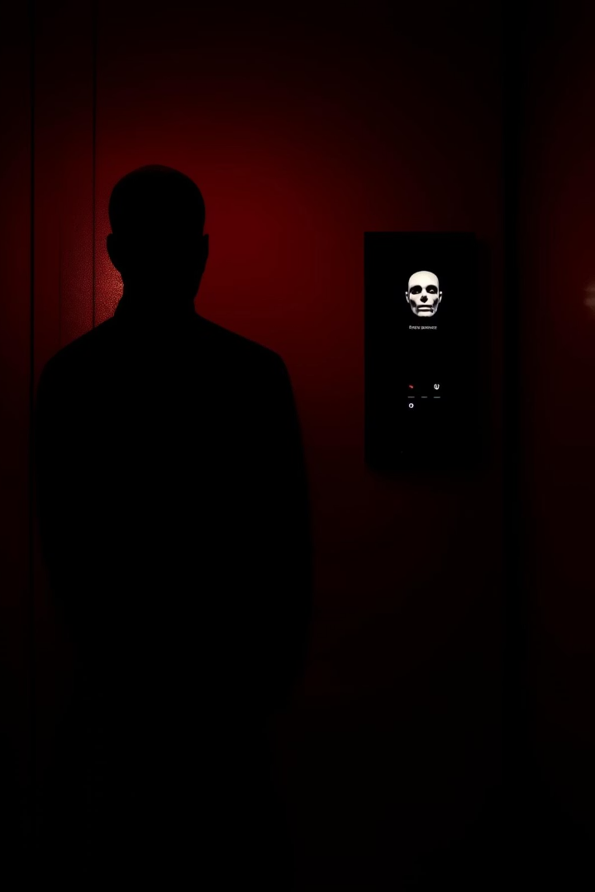
Benefits of Implementing FRAS
Accuracy
Efficiency
FRAS significantly reduces human errors in attendance tracking, ensuring reliable and precise records that reflect actual presence. Automatic verification eliminates manual recording mistakes common in traditional systems.
The system dramatically speeds up the attendance process, eliminating queues and saving valuable time. Students can be verified in less than a second, allowing them to proceed directly to their workstations.
Cost-effectiveness
Despite initial investment, FRAS reduces long-term administrative overhead by eliminating physical cards, time clocks, and manual record-keeping. Educational institutions report up to 15% reduction in attendance-related errors, translating to significant savings.

Slide 5





Implementation Steps
Data Collection
Gather facial images of all students under controlled conditions using the webcam, capturing 10 images per student with histogram equalization for lighting consistency.
Training the Model
Develop and fine-tune face recognition algorithms using face_recognition to generate and store encodings in encodings.pkl for accurate face matching.
System Integration
Connect FRAS with existing classroom management systems or local attendance logs (e.g., attendance.csv) for seamless data flow.
Testing
Ensure accuracy and reliability through comprehensive testing, verifying face recognition (<0.5 threshold) and attendance
ogging in real-time scenarios.
Deployment
Roll out the system to all users with proper training
A complete FRAS implementation typically takes 1-2 months, depending on the number of students and complexity. The timeline includes initial setup, system customization, user training, and fine-tuning phases.

Slide 6
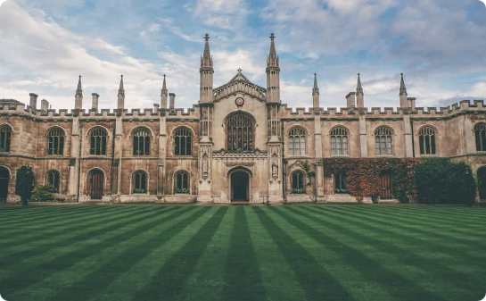

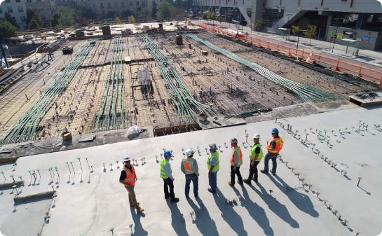
Use Cases and Applications
Educational Institutions
Corporate Environments
Specialized Workplaces
Schools and universities use FRAS to automate student attendance, reducing administrative burden and allowing real-time tracking of classroom presence. University Y reported annual savings of $20,000 after implementing FRAS across campus.
Businesses implement FRAS for employee attendance tracking and access control, enhancing security while streamlining HR processes. The system integrates with payroll systems for automatic time tracking and reporting.
Construction sites use FRAS to monitor worker presence and compliance with safety regulations. Healthcare facilities employ the technology to track staff attendance and optimize patient flow management through secured areas.

Slide 7








Challenges and Considerations
Privacy Concerns
Technical Issues
Educational institutions must navigate regulations like GDPR and CCPA when implementing facial recognition. Proper consent protocols and transparent data policies are essential to protect student privacy.
Environmental factors such as poor lighting, face occlusions (e.g., masks, glasses), and system limitations can affect recognition accuracy and reliability, mitigated by histogram equalization and mediapipe detection.
Ethical Implications
Security Vulnerabilities
Developers and institutions must ensure algorithms are tested for bias across different demographics to provide fair and equitable recognition, aligning with educational equity standards.
Systems must be protected against spoofing attempts using photographs or deepfakes, requiring advanced liveness detection features (a potential future enhancement for FRAS).

Slide 8
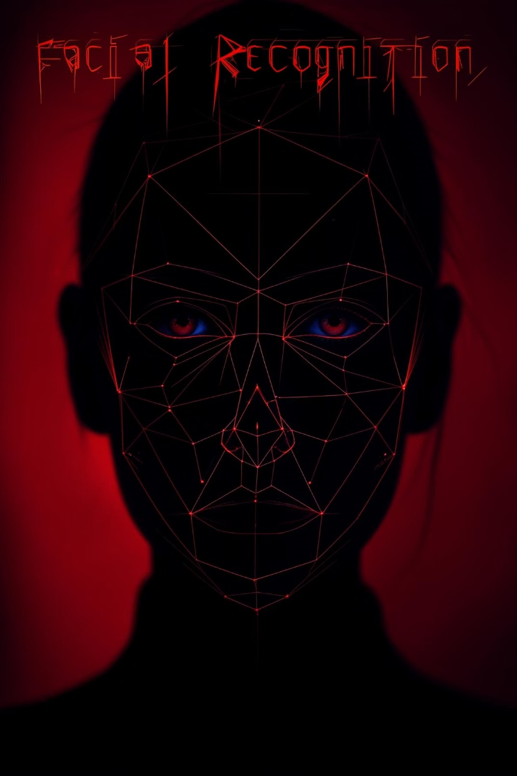
Future Trends and Innovations
1
AI Integration
Advanced machine learning algorithms will continue improving recognition accuracy and processing speed.
2
IoT Connectivity
Integration with smart building systems will enable automated environment adjustments based on occupancy.
3
Multimodal Biometrics
Combining facial recognition with other biometric methods like voice or fingerprint analysis for enhanced security, preventing proxy attendance in educational settings
4
Edge Computing
Processing facial data locally on devices rather than in the cloud, reducing latency and privacy concerns.
As facial recognition algorithms continue to evolve, we can expect even greater accuracy rates and resistance to spoofing attempts. The technology will likely become more accessible to smaller organizations through cloud-based solutions and subscription models.

Slide 9
THANK YOU

